Slide 1
HS 200
Environmental Studies
S. Pattanaik
(spattanaik@iitb.ac.in)
Department of H&SS

Slide 2
Why Social aspects of Environment?
What do we mean by Environment ? Why it is important today?
Development vis-à-vis Environment
Nexus between Development- -Environmental degradation-Poverty

Slide 3
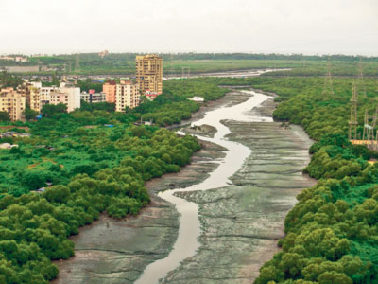
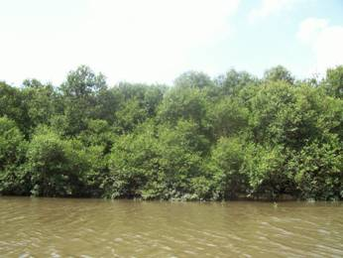
Mangroves in Mumbai

Slide 4
Major Environmental Challenges Faced by India
Growing population
Poverty
Agricultural growth
Need to ground water
Development and forests
Degradation of land
Evil consequences of urbanization

Slide 5
Cluster of environmental concerns –Global

Slide 6

Emerges in the 1960s
Pollution: pesticides in soil and water; oil spills; acid rain;
Energy: depletion of fossil fuels
Research and intellectual engagements:-
Earlier in the 20th century:
British attempts to improve public health, water supplies, sanitation;
German science of conservation biology, forestry;
US concepts of wilderness protection
1960s Ecological approach to Nature
Chemicals in the food-chain,
Rachel Carson: Silent Spring, 1962
‘

Slide 7
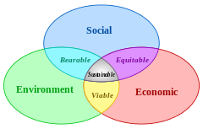
Sustainable development

Slide 8
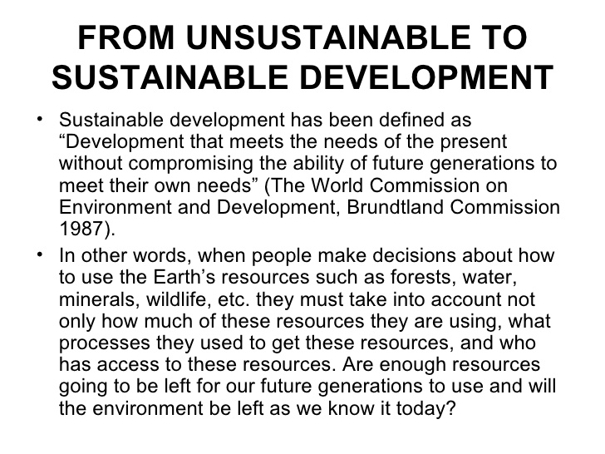
Why Sustainable Development?

Slide 9
Sustainable Development
Environmental Degradation
Declining Stocks and Flows
Summits on E&D
“Our” Common Future
Needs of the Present and Needs of the Future
What and Whose ‘needs’?

Slide 10
Summits on Environment & S-D- 1987-2002
Brundtland Commission Report (1987)
Report on ‘Our Common Future’-1987
Definition on S-D (WCED)
The definition provides two concepts:
1. The concept of present needs (Needs of the World’s poor to which overriding priority should be given);
2. The idea of limitations imposed by the state of technology & social organization on the environment’s ability to meet present & future needs.

Slide 11
Contd…..Summits on Environment & S-D- 1987-2002
Rio 1992: Sustainable Development and Environment Focused (Agenda 21, The Convention on Biological Diversity )
Johasberg Conference, 2002
main objectives of S-D were (2002)
Combating poverty,
Empowering people,
Using core competence in Science and Technology,
Seeing Environmental Standards: Conserving of natural resources, Improving core sectors of Economy.

Slide 12
Dimensions of Development
ECONOMIC
POWER
SD
SOCIAL
ENVIORNMENTAL
SD: Field of Sustainable Development

Slide 13
S-D on Envirment and Development
Access?
Control?
Equity?
Sustainability→Conflicts?

Slide 14
Conflicts within Sustainable Development
Between:
the present and future generations
human well-being and the protection of nature
the poor and rich
a local and a global focus: ‘Here’ and ‘Elsewhere’

Slide 15
environmental Conflicts in India

Slide 16
Documentary The many faces of Madness
This film with its images of contemporary ecological destruction in India brings people face to face with the intensity and impact of globalization and industrialization, of commerce and greed, as it travels through images from different parts of India, revealing glimpses of traditional water harvesting
systems, mining, chemical pollution, community forest protection, displacement, deforestation, biopiracy and coastal ecosystems. The film had won the second prize at New Delhi Video Forum Festival 2001.

